Slide 1
Section 2.4 Reciprocal of a Function
i) Concept of Reciprocal Functions
ii) Asymptotes, Invariant Points,
iii) Graphing the Reciprocal of Linear and QF
iv) Domain and Range
© Copyright all rights reserved to Homework depot: www.BCMath.ca

Slide 2
I) What is a Reciprocal ?
the reciprocal is a number is obtained when we switch the value of the numerator (Top) and the denominator (Bottom) with each other
Ex: Find the reciprocal of each number:
Note: the reciprocal of 1 and – 1 will stay the same
The reciprocal of 0 is undefined, can’t divide by zero
The reciprocal a small number becomes much bigger
The reciprocal of a big number becomes smaller
© Copyright all rights reserved to Homework depot: www.BCMath.ca

Slide 3
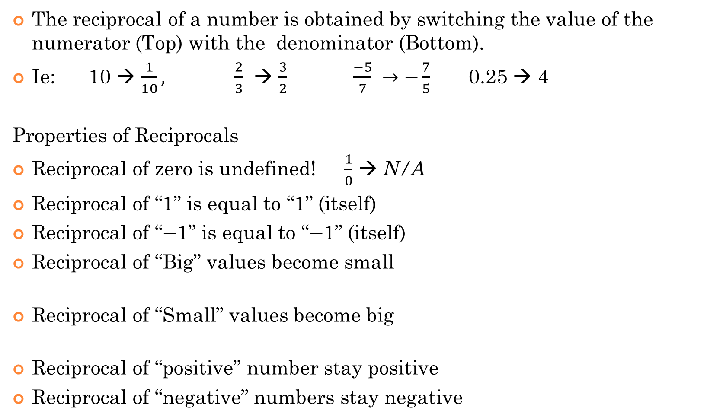
What is a Reciprocal?
The reciprocal of a number is obtained by switching the value of the numerator (Top) with the denominator (Bottom).
Ie: 10 → $\frac{1}{10},$ $\frac{2}{3}$ → $\frac{3}{2}$ $\frac{−5}{7} →−\frac{7}{5}$ 0.25 → 4
Properties of Reciprocals
Reciprocal of zero is undefined! $\frac{1}{0}$ → N/A
Reciprocal of “1” is equal to “1” (itself)
Reciprocal of “$−$1” is equal to “$−$1” (itself)
Reciprocal of “Big” values become small
Reciprocal of “Small” values become big
Reciprocal of “positive” number stay positive
Reciprocal of “negative” numbers stay negative

Slide 4
II) Properties of Reciprocal Functions
The reciprocal of a function is obtained by taking the original function, put in the denominator, and place a “1” in the numerator
Original Functions:
Reciprocal Functions:
When taking the reciprocal of a function, the “input” values “x” do not change, they stay the same
The output values “y” are “flipped”, becomes the reciprocal, $\left(x,\frac{a}{b}\right) →$ $\left(x,\frac{b}{a}\right)$

Slide 5
Ex: Given the table of values on the left, fill in the table of values on the right
Linear Function:
Reciprocal of Linear Function:
© Copyright all rights reserved to Homework depot: www.BCMath.ca

Slide 6
iii) Steps Graphing Reciprocal Functions
1st Graph the function in your denominator, if the graph of the function is provided, you can skip this step
2nd: Look for the “x” intercepts in your graph $(a,0)$ , these points will become vertical asymptotes: $x≠a$
3rd: Look for “invariant points” $(a,1)$ and $(a,−1)$, these are points that don’t change because the Y-coordinate is 1 or $−1$.
The invariant points [common points] are points on the graph where both the function and the reciprocal function will intersect each other
4th Pick some points near the x-axis, the reciprocal of these points will be far from the x-axis $ie: (a,0.05)$ → $(a,20)$
Likewise, points far from the x-axis will become very close to the x-axis
Keep in mind: If graph is positive, reciprocal also positive
If graph is negative, reciprocal also negative

Slide 7
Practice: Given the following graph, draw the reciprocal function
y
Find the x-intercept → Vertical
Asymptote
5
Find common points with a
Y-coordinate of 1 or -1
Pick some points on the original
Function and take the reciprocal
of the Y-coordinate
x
-5
0
5
Reciprocal of large numbers
will become small
Reciprocal of small numbers
will become large
-5
© Copyright All Rights Reserved Homework Depot www.BCMath.ca

Slide 8
Ex) Graph and Find Domain and Range:
1. First graph the line:
4. Take the reciprocal of the
Y coordinate for every point
y = 0.5x+1
2. Find X-intercept (when y = 0)
→ Vertical Asymptotes
3. Find Common Points: Points where the Y-coordinate is 1 or -1
© Copyright all rights reserved to Homework depot: www.BCMath.ca

Slide 9
Ex: Given each coordinate on the left, match it with the corresponding point on the reciprocal function:

Slide 10
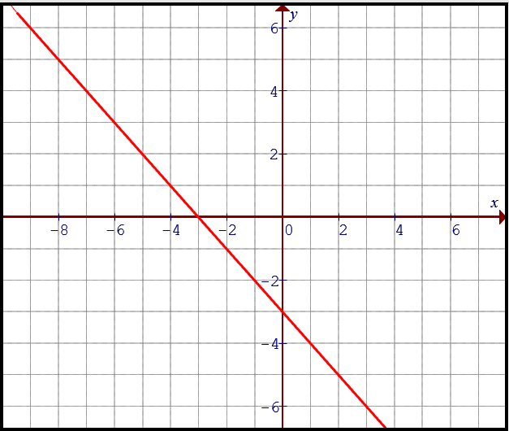
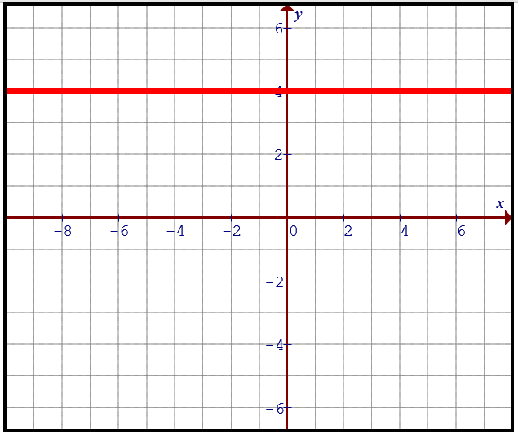
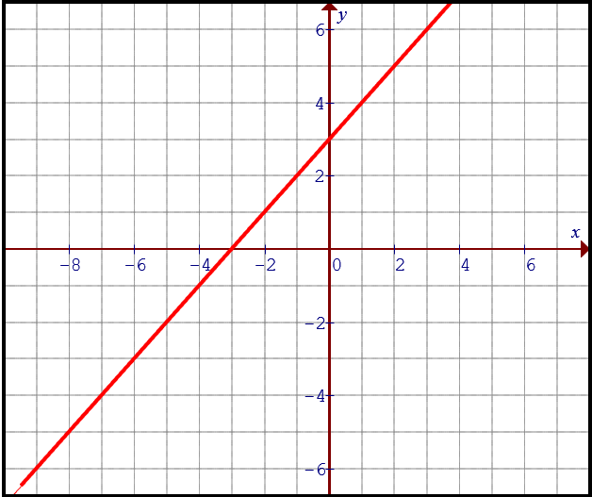
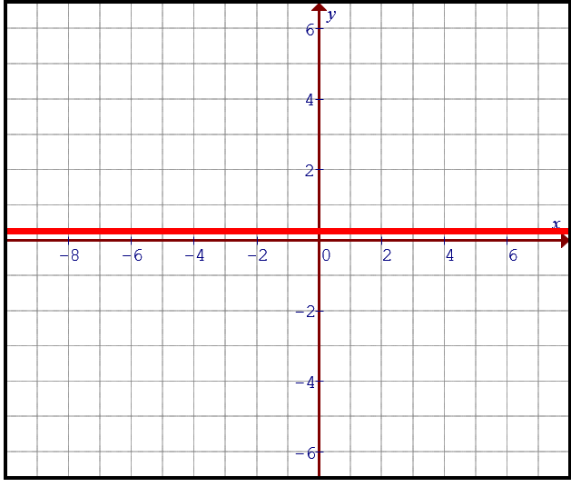
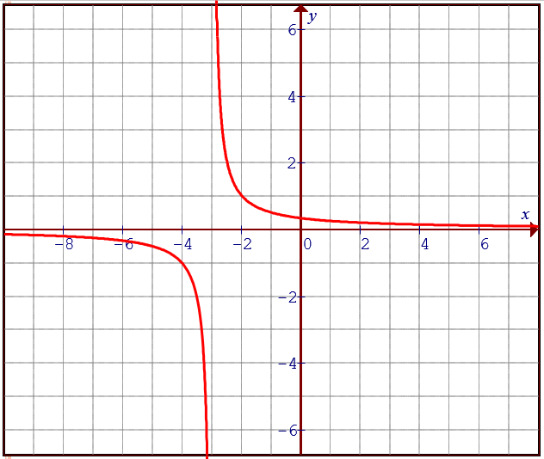
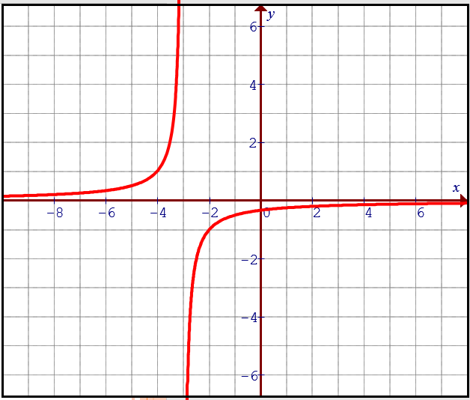
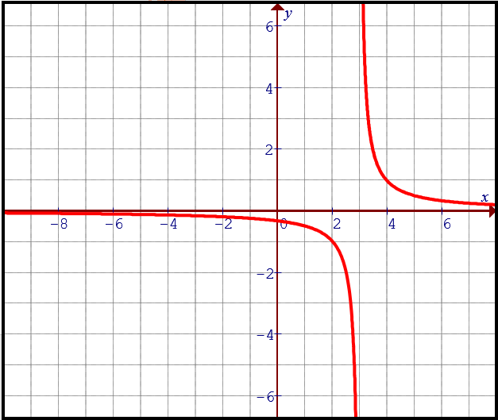
Ex: Please match each graph on top with the corresponding reciprocal function below:
A)
B)
C)
D)

Slide 11
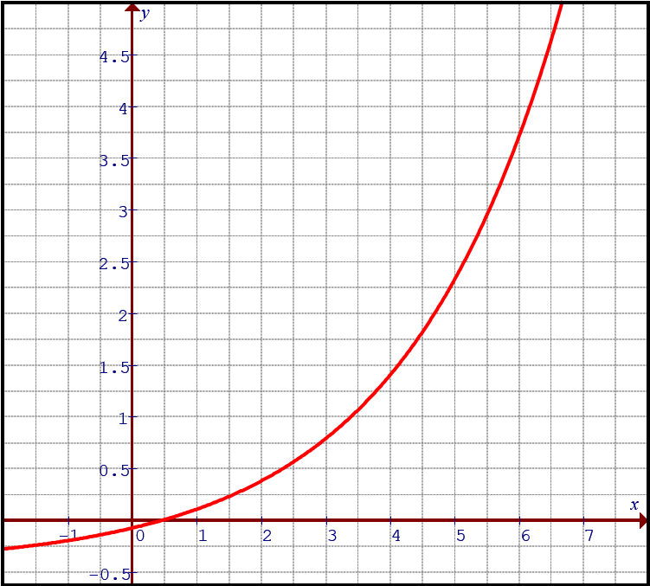
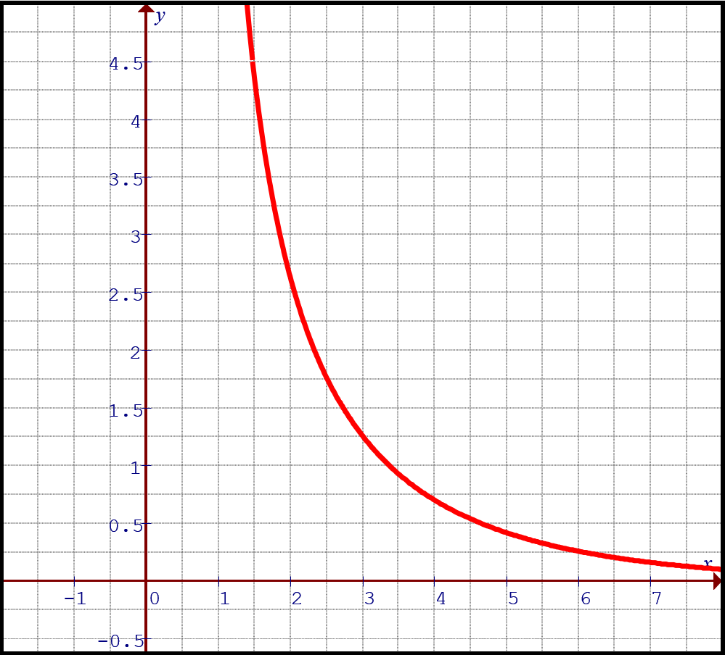
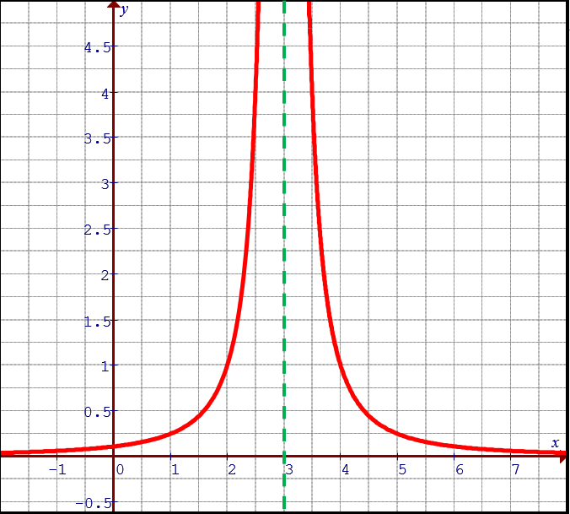
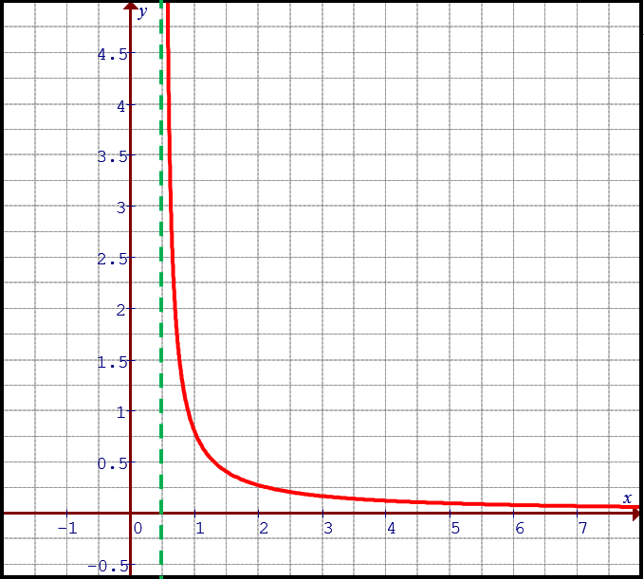
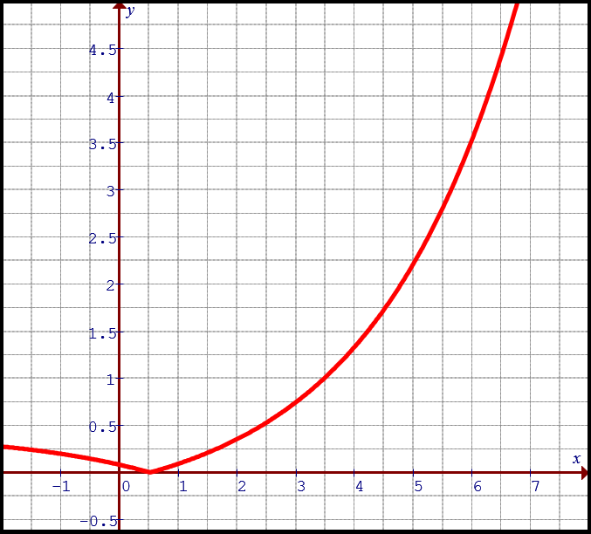
Ex: Given the following points on the curve, which of the following is the reciprocal of the given graph?
A)
B)
C)
D)

Slide 12
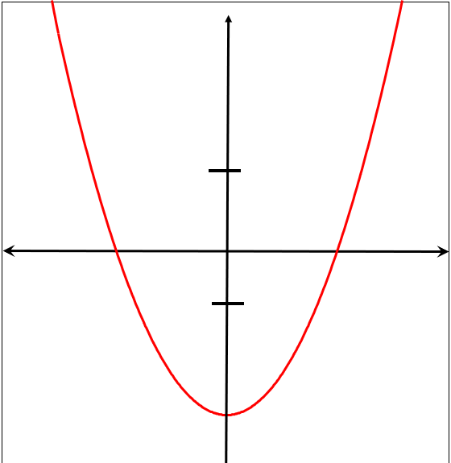






Graphing the reciprocal of a Quadratic function:
1. If a quadratic function has two X-intercepts, then each of those x-intercepts will become a vertical asymptote
2. Common points occur when the y-coordinate is either 1 or -1. So a parabola can have up to four common points.
There are two in the middle and one each on the left and right
3. There will be 3 parts of the reciprocal function: LEFT, MIDDLE, and RIGHT.
4. Draw the reciprocal starting from the asymptote.
5. Near → Far, Far → Near (with respect to X- axis)

Slide 13
Practice: Graph the following
y
Pick some points on the original
Function and take the reciprocal
of the Y-coordinates.
Reciprocal of large numbers
will become small
Reciprocal of small numbers
Will become large
Graph
5
Find X-intercept →Asymptotes
x
Find the Common Points where
Y coordinate is 1 or -1.
-5
0
5
-5

Slide 14
Practice: Graph the function
ii)Find the equation of the asymptotes
iii) Find the coordinates of the Invariant points
iv) Indicate the domain and range of the reciprocal function

Slide 15
Practice: Graph the function
ii)Find the equation of the asymptotes
iii) Find the coordinates of the Invariant points
iv) Indicate the domain and range
y
10
x
-5
0
5
-10

Slide 16
Practice: Graph the function
ii)Find the equation of the asymptotes
iii) Find the coordinates of the Invariant points
iv) Indicate the domain and range
y
5
x
-5
0
5
-5

Slide 17
Graph the reciprocal of each parabola
y
y
5
5
x
x
-5
0
5
-5
0
5
-5
-5
Use the first x-intercept to draw the
Vertical asymptote
There are no x-intercepts, so no VA
Only one invariant point
Plot the invariant points
Graph each side of the asymptote
© Copyright all rights reserved to Homework depot: www.BCMath.ca

Slide 18
Ex#) Given the following graph f(x), graph the reciprocal function.
Find X-intercept
→Asymptotes
Find Common Points
Near to Far &
Far to Near
© Copyright all rights reserved to Homework depot: www.BCMath.ca

Slide 19
Given the following function, Find equation of all the vertical asymptote, Coordinates of Invariant points, and indicate the domain and Range:
© Copyright all rights reserved to Homework depot: www.BCMath.ca

Slide 20
Given the following function, indicate the domain and Range:

Slide 21
Given the following function, indicate the domain and Range:

Slide 22
Given the following function, indicate the domain and Range:

Slide 23
Given the following function, indicate the domain and Range:

